Slide 1
Clean Architecture
Programming Palli

Slide 2
Clean Architecture
The Clean Architecture is a software architectural concept that aims to create modular and maintainable software systems.

Slide 3
History
Clean architecture was created by Robert C. Martin(Uncle Bob).
It evolved over time from several other architectures including Hexagonal Architecture, Ports and Adapters, and Onion Architecture.

Slide 4
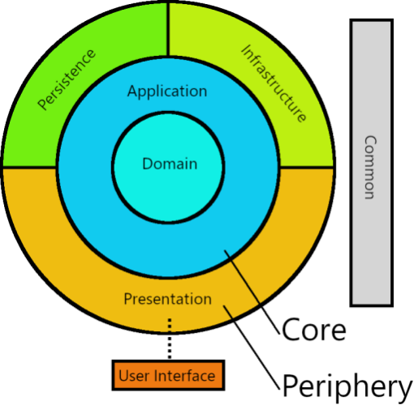
Clean Domain-Driven Design

Slide 5
Domain Layer
Domain layer is the core layer.
Core business logic.
Entities.
Business rules.
Aggregates.
Valu objects.
Enums.

Slide 6
Application Layer
Application Layer as the "heart" of the application.
Service interfaces.
Error handling.
Data transformation and validation.

Slide 7
Persistence Layer
The Persistence layer contains implementations for the persistence interfaces declared in the Application layer.
Separation from business logic.
Database interaction.
ORM.
Repositories.
Data mapping.
Decoupling from framework.

Slide 8
Infrastructure Layer
The Infrastructure layer contains implementations for the infrastructure interfaces declared in the Application layer.
Separation from business logic.
External APIs.
File system and I/O.
External Services.(Email,Payment).

Slide 9
Presentation Layer
The presentation layer is an API layer.
Separation from business logic.
Dependency Injection.

Slide 10
User Interface
This is the code that users directly interact with.
Web application.
Desktop application.
Mobile application.

Slide 11
Common Layer
The common layer is a library which it is global to the entire system.
Cross-cutting concerns.
Date Time.
Configuration.

Slide 12
Question?

Slide 13
Thank You
Please subscribe

